Slide 1


Top Discriminator Efficiencies and Signal Over Bkg for several selection Categories NTUA
Giannis Papakrivopoulos
George Bakas

Slide 2
Overview
Efficiencies vs mTTbarParton
Signal over Background for
Mtt samples over Bkg
Nominal sample over Bkg
Yields for all samples
All Signal over Bkg are vs mJJ
Categories:
1. Both jets are top tagged and b tagged
2. 1 Jet top and b tagged and other jet top tagged
3. 1 Jet top and b tagged and other jet b tagged
4. Both jets are top tagged
5. Both jets are b tagged
Cuts:
Reco:
nJets > 1,
|jetEta| < 2.4 (both jets)
jetPt > 400 GeV (both jets)
120 GeV < jetMassSoftDrop < 220 GeV (both jets)
Parton:
|etaParton| < 2.4 (both partons)
ptTopParton > 400 GeV (both partons)
mTTbarParton > 1000

Slide 3
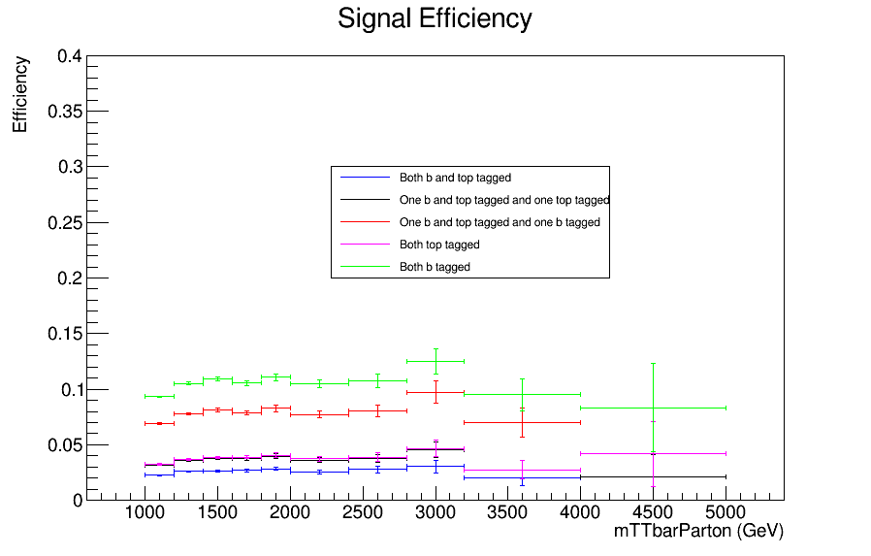
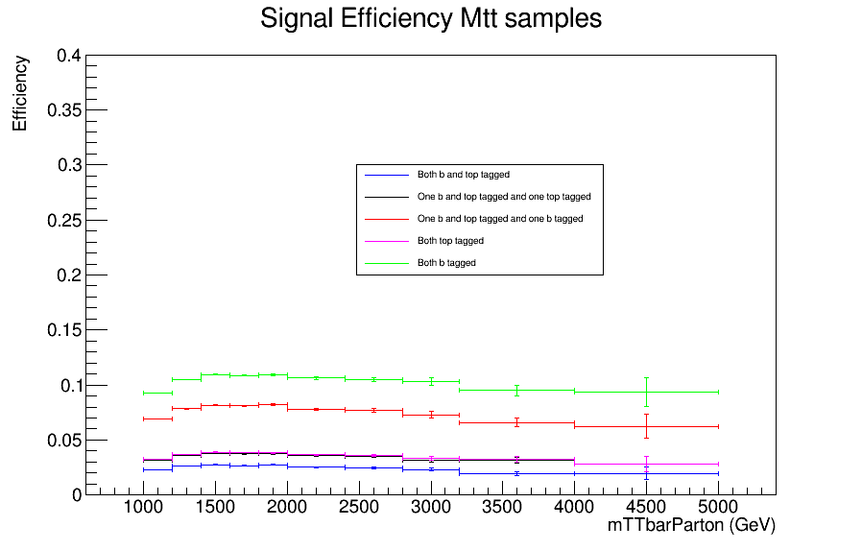
Efficiency vs mTTbarParton
Top tagger cut : 0.6
B-tagging: Loose working point
nominal TT_TuneCUETP8M2T4_13TeV-powherg-pythia8
Mtt Samples

Slide 4
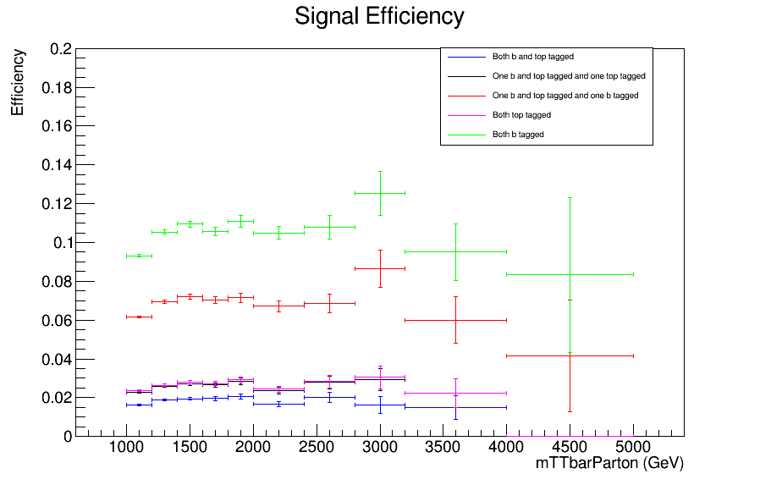
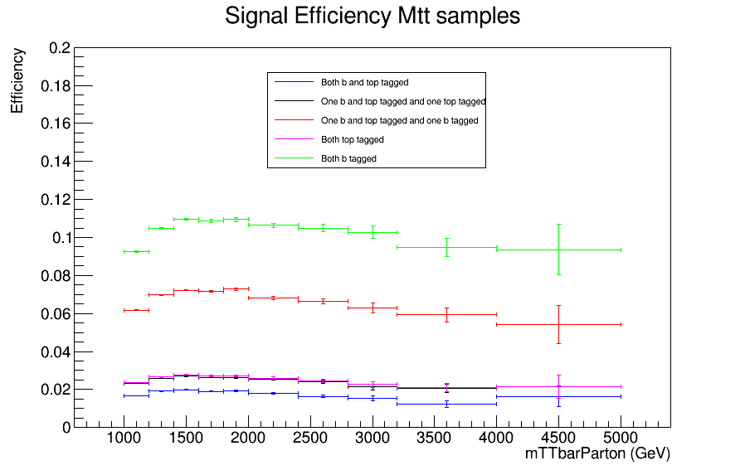
Efficiency vs mTTbarParton
Top tagger cut : 0.7
B-tagging: Loose working point
nominal TT_TuneCUETP8M2T4_13TeV-powherg-pythia8
Mtt Samples

Slide 5
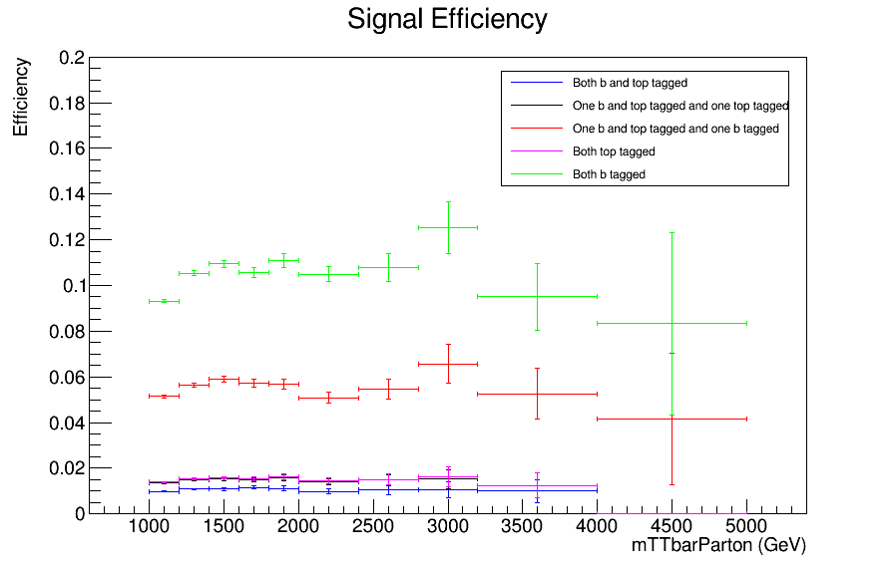
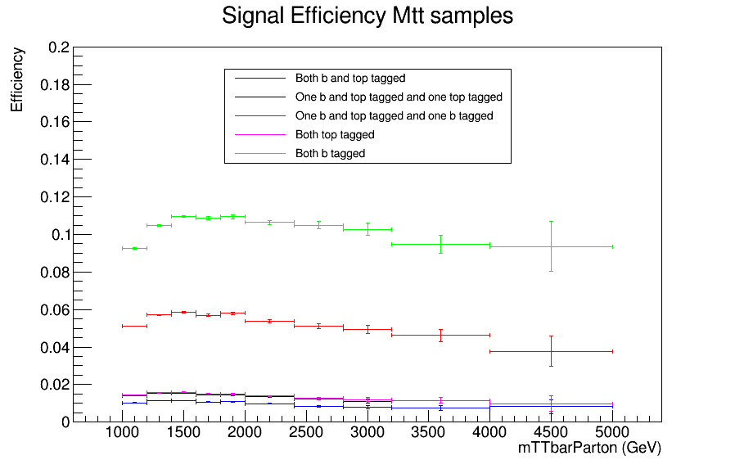
Efficiency vs mTTbarParton
Top tagger cut : 0.8
B-tagging: Loose working point
nominal TT_TuneCUETP8M2T4_13TeV-powherg-pythia8
Mtt Samples

Slide 6
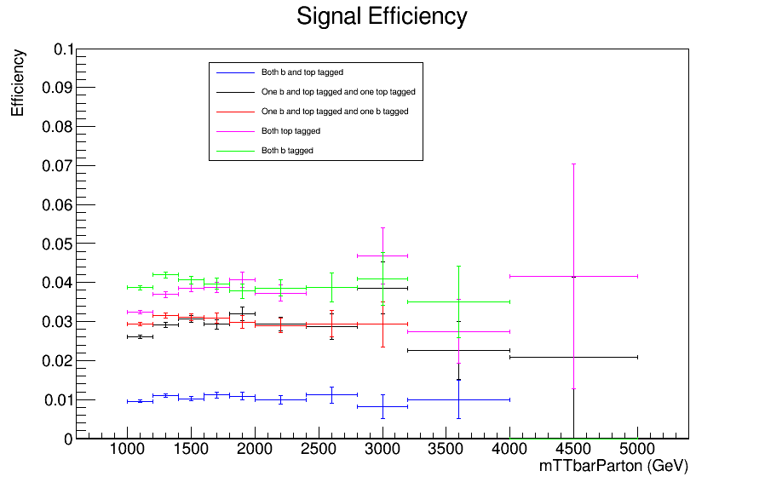
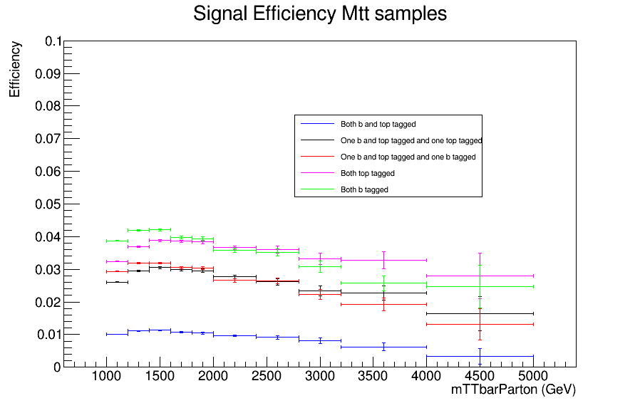
Efficiency vs mTTbarParton
Top tagger cut : 0.6
B-tagging: Medium working point
nominal TT_TuneCUETP8M2T4_13TeV-powherg-pythia8
Mtt Samples

Slide 7
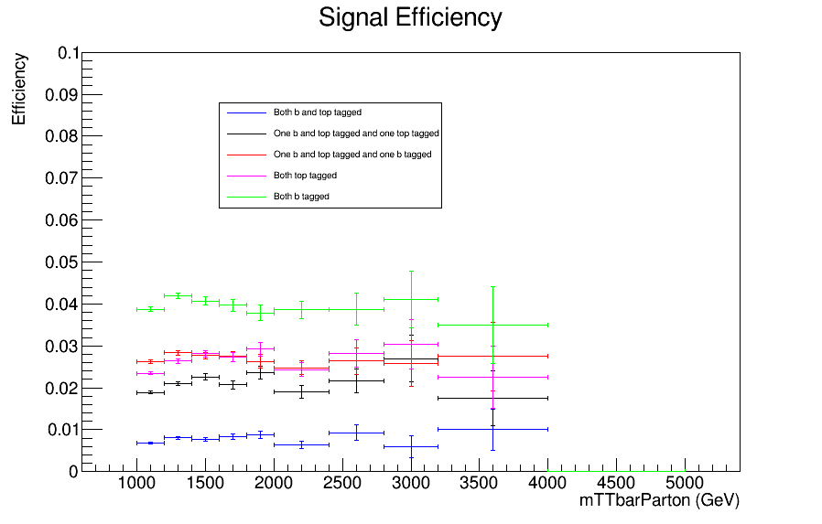
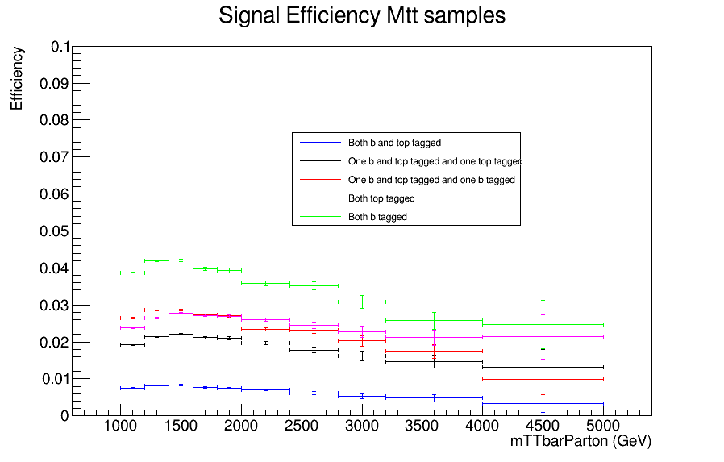
Efficiency vs mTTbarParton
Top tagger cut : 0.7
B-tagging: Medium working point
nominal TT_TuneCUETP8M2T4_13TeV-powherg-pythia8
Over Bkg (All Categories)
Mtt Samples

Slide 8
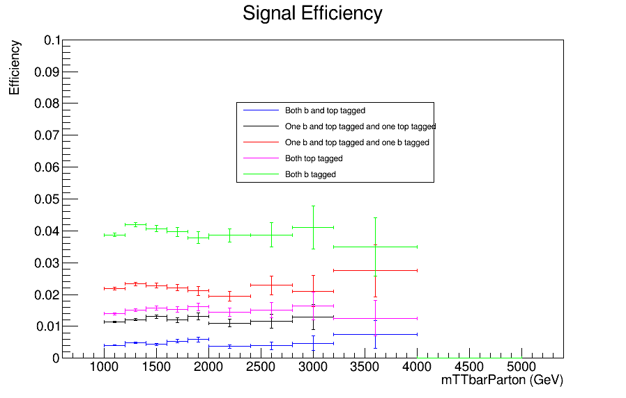
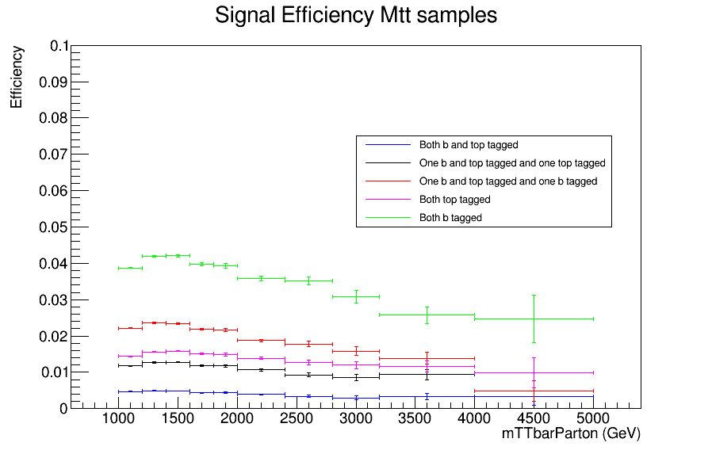
Efficiency vs mTTbarParton
Top tagger cut : 0.8
B-tagging: Medium working point
nominal TT_TuneCUETP8M2T4_13TeV-powherg-pythia8
Mtt Samples

Slide 9
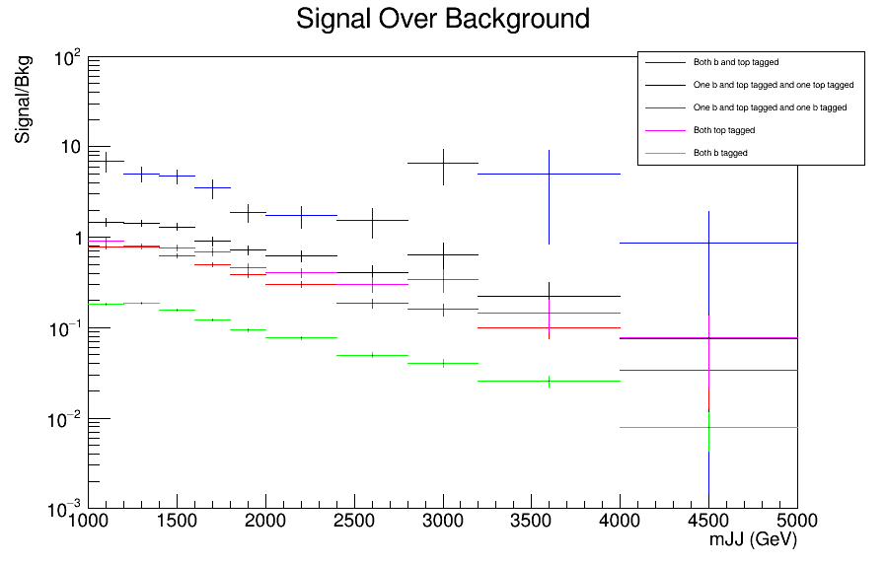
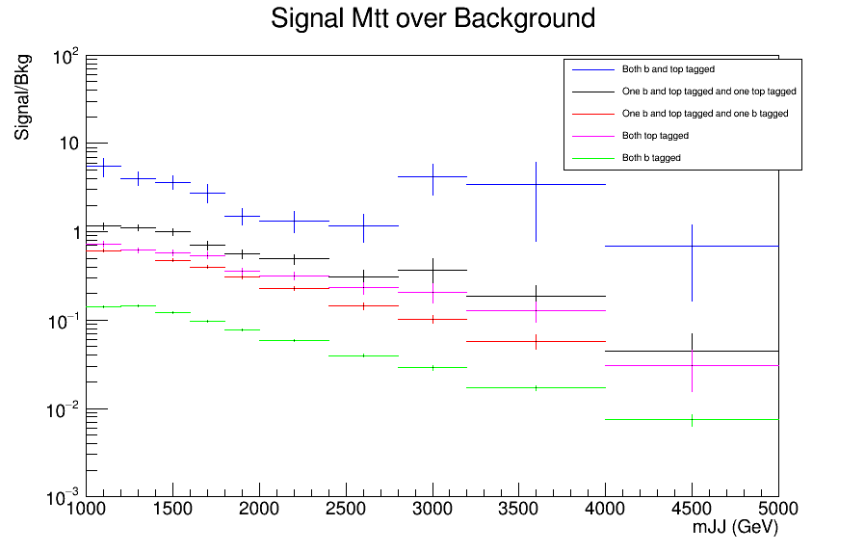
Signal over Bkg for mJJ (reco)
Top tagger cut : 0.6
B-tagging: Loose working point
nominal TT_TuneCUETP8M2T4_13TeV-powherg-pythia8
Over Bkg (All Categories)
Mtt Samples

Slide 10
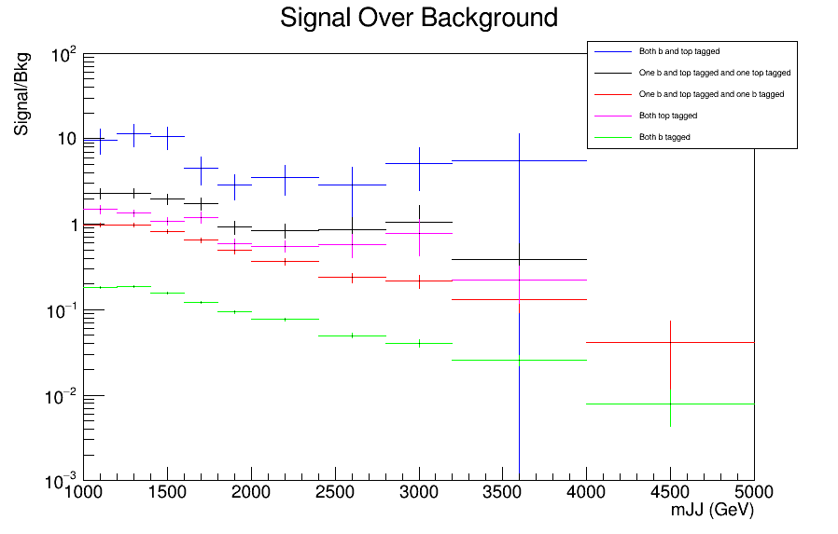
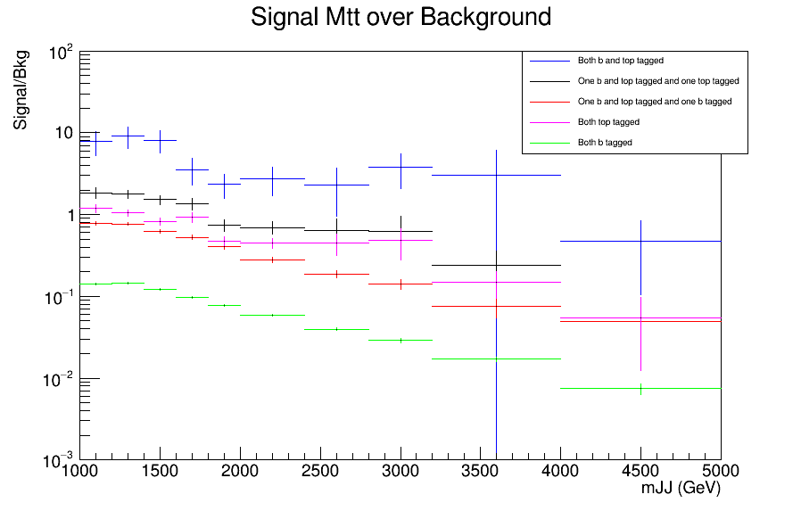
Signal over Bkg for mJJ (reco)
Top tagger cut : 0.7
B-tagging: Loose working point
nominal TT_TuneCUETP8M2T4_13TeV-powherg-pythia8
Over Bkg (All Categories)
Mtt Samples

Slide 11
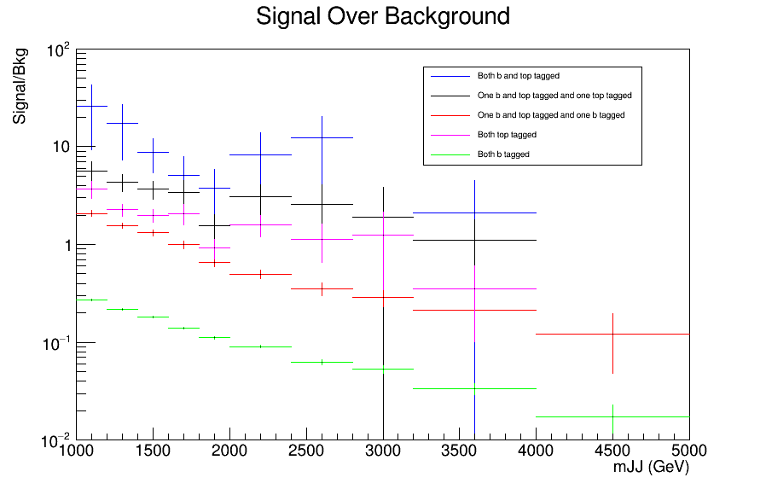
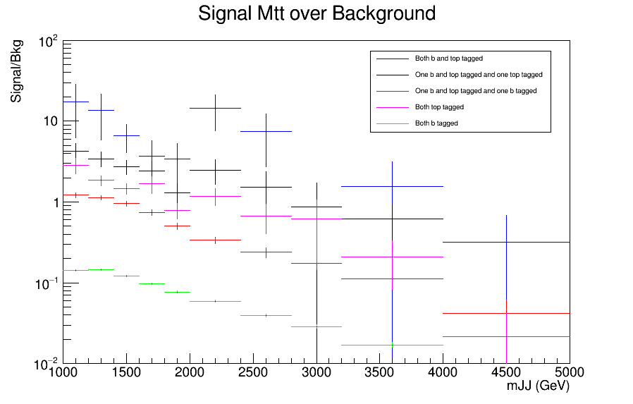
Signal over Bkg for mJJ (reco)
Top tagger cut : 0.8
B-tagging: Loose working point
nominal TT_TuneCUETP8M2T4_13TeV-powherg-pythia8
Over Bkg (All Categories)
Mtt Samples

Slide 12
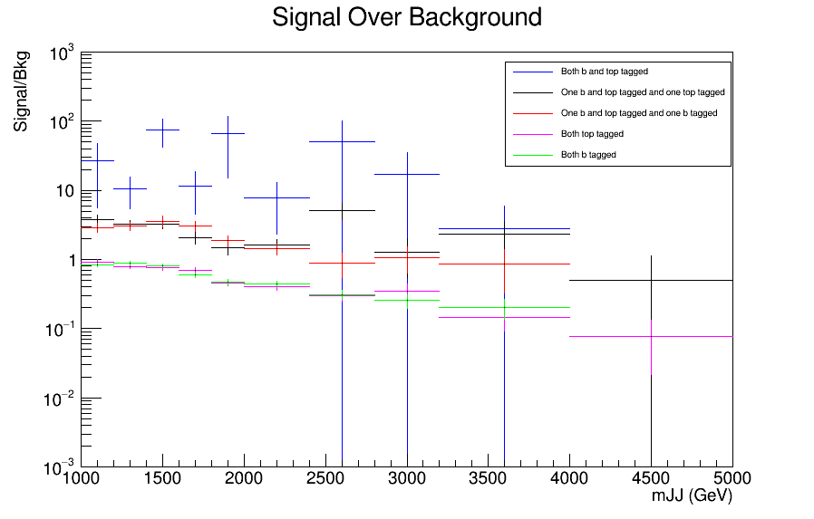
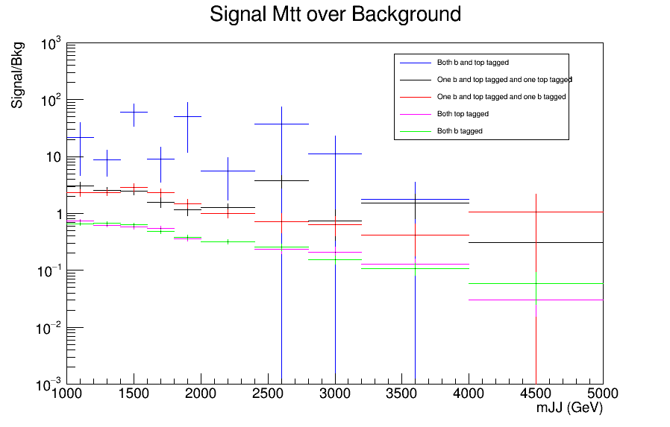
Signal over Bkg for mJJ (reco)
Top tagger cut : 0.6
B-tagging: Medium working point
nominal TT_TuneCUETP8M2T4_13TeV-powherg-pythia8
Over Bkg (All Categories)
Mtt Samples

Slide 13
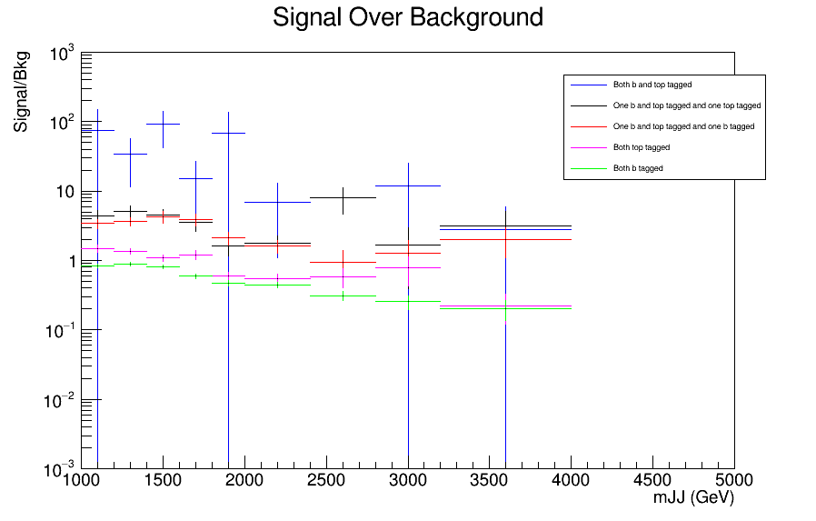
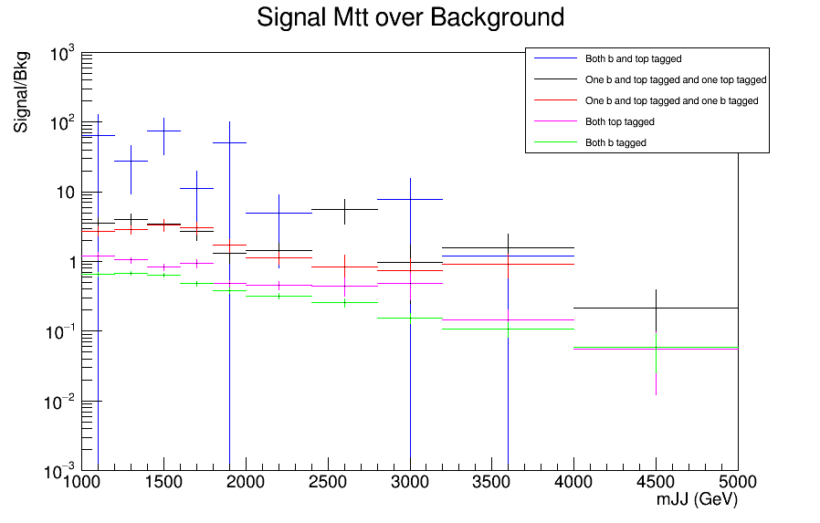
Signal over Bkg for mJJ (reco)
Top tagger cut : 0.7
B-tagging: Medium working point
nominal TT_TuneCUETP8M2T4_13TeV-powherg-pythia8
Over Bkg (All Categories)
Mtt Samples

Slide 14
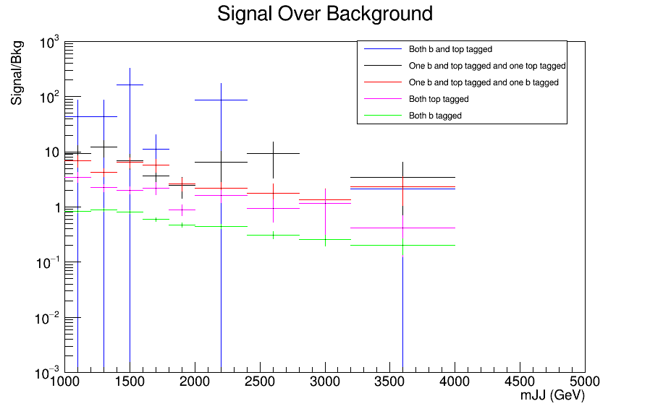
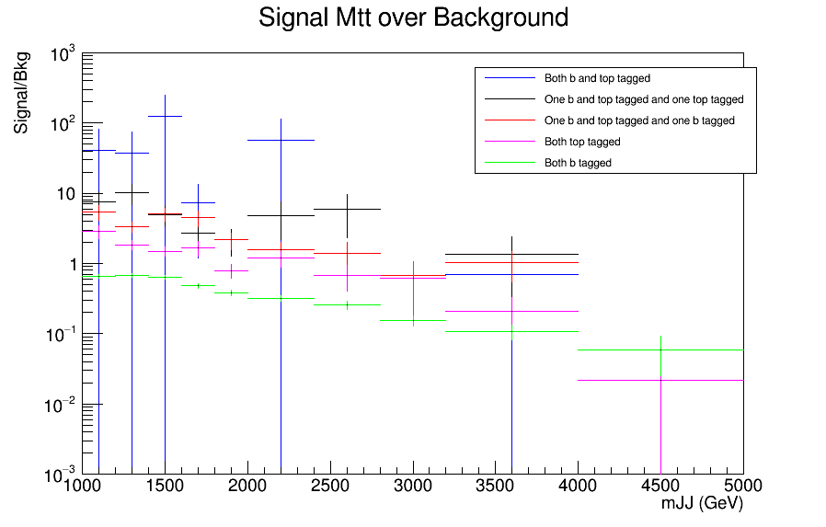
Signal over Bkg for mJJ (reco)
Top tagger cut : 0.8
B-tagging: Medium working point
nominal TT_TuneCUETP8M2T4_13TeV-powherg-pythia8
Over Bkg (All Categories)
Mtt Samples

Slide 15
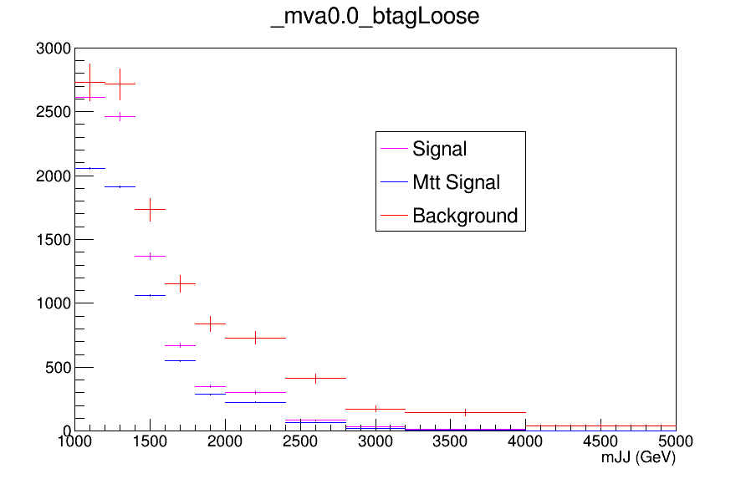
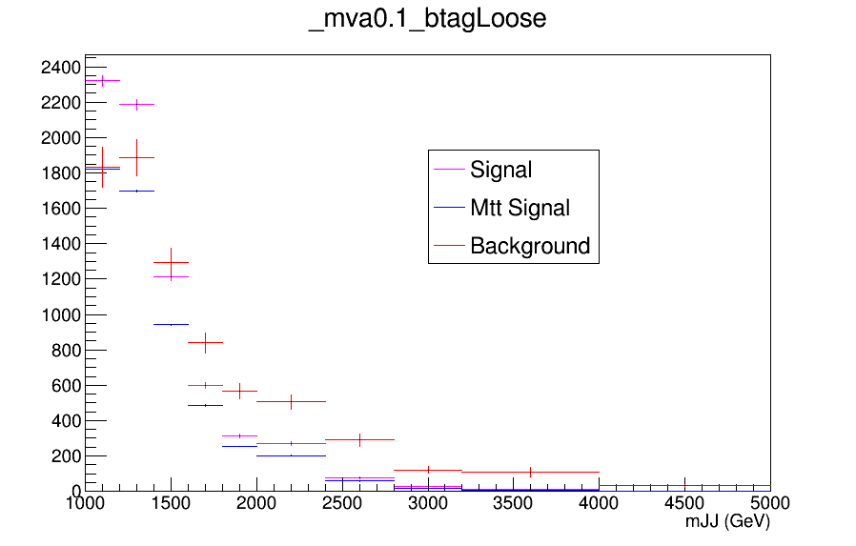
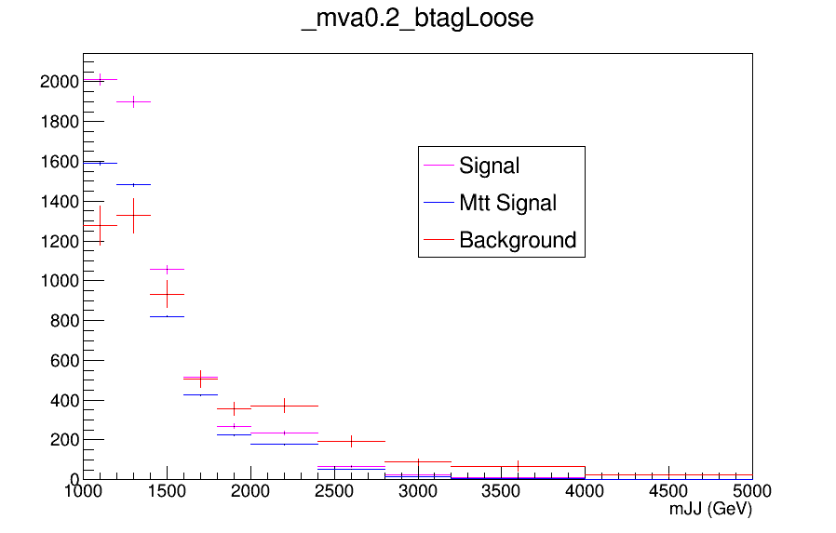
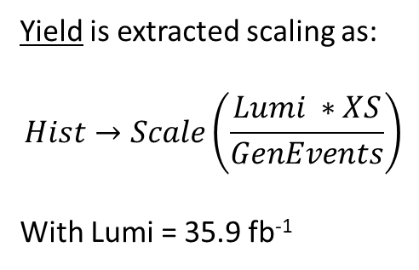
Yields for Combinations of mva and b tagging
Yield is extracted scaling as:
$$Hist→Scale\left(\frac{Lumi ∗XS}{GenEvents}\right)$$
With Lumi = 35.9 fb⁻¹

Slide 16
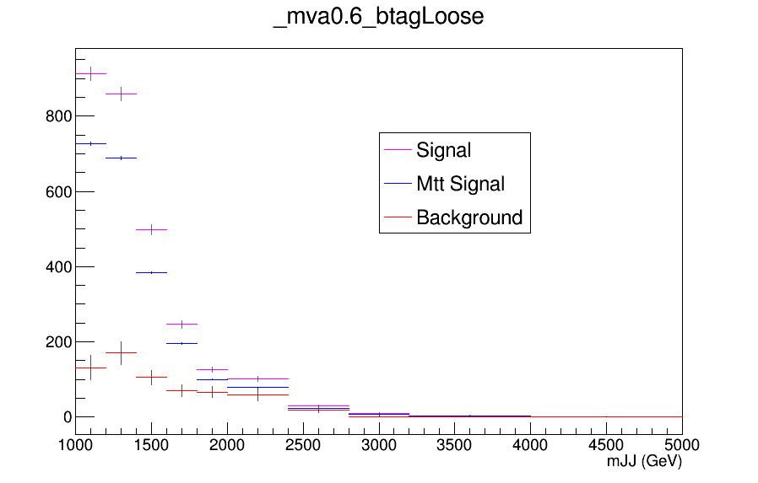
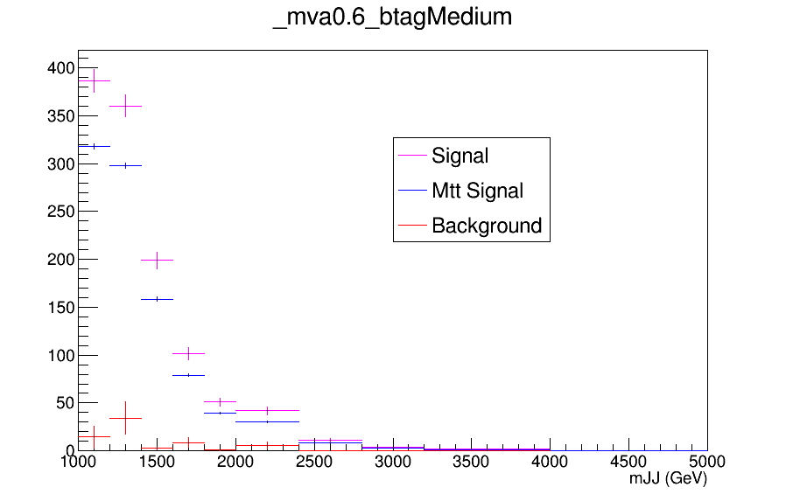
Yields for Combinations of mva and b tagging

Slide 17
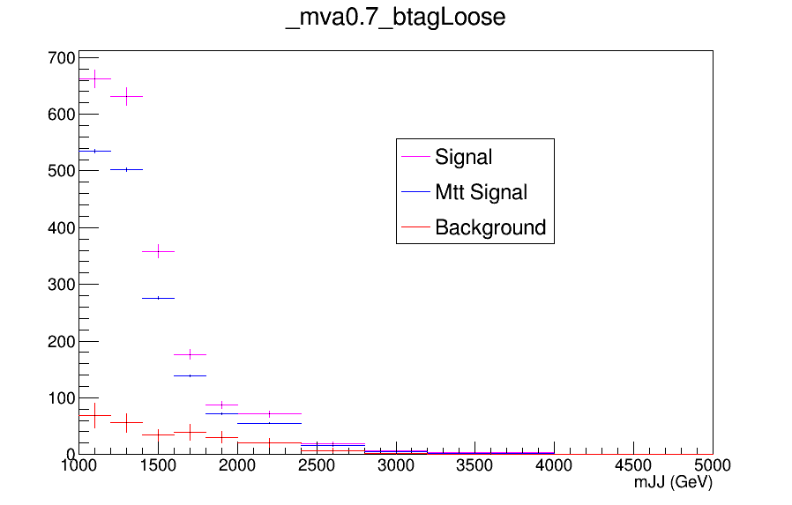
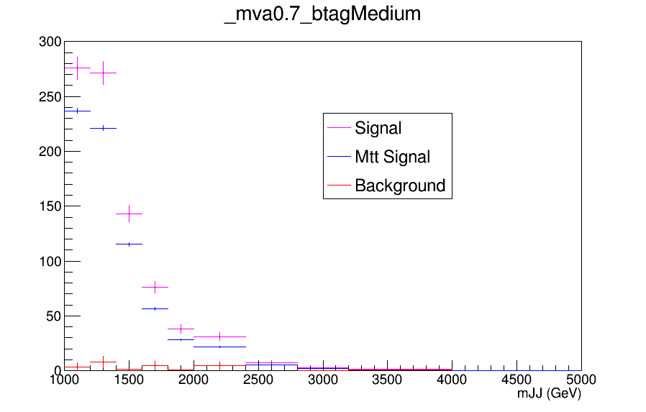
Yields for Combinations of mva and b tagging

Slide 18
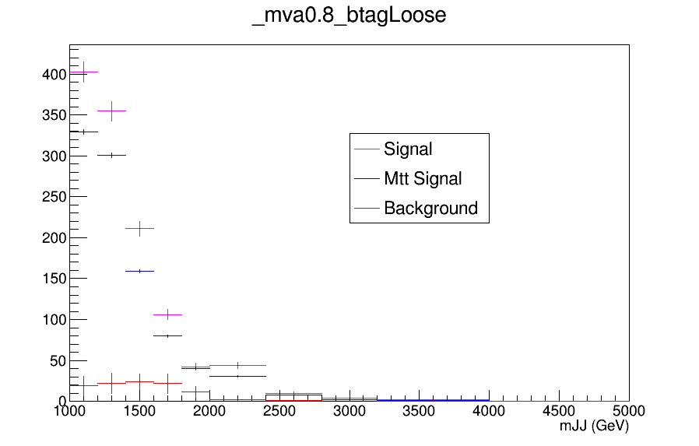
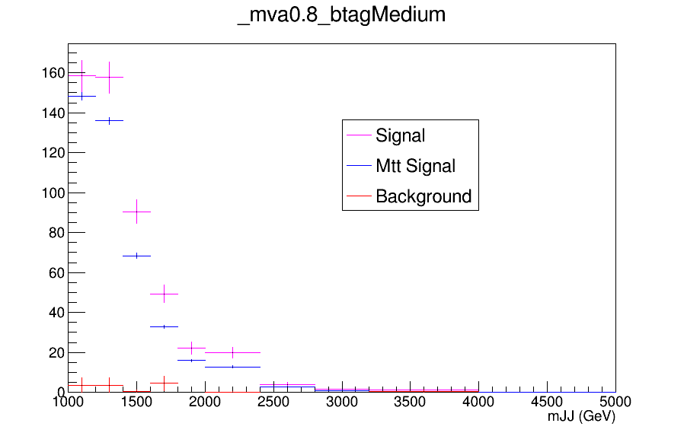
Yields for Combinations of mva and b tagging

